Slide 1
Helping Hat
Adam Cotter – IoT 2nd Year
GitHub repo - https://github.com/aaccttrr/IoTProjectSemester2

Slide 2
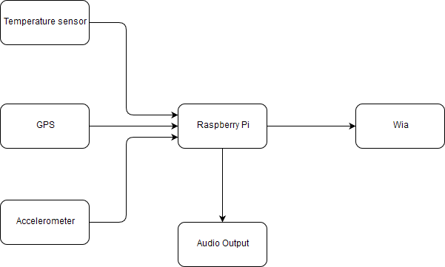
Overview
The helping hat is a hat with a Raspberry Pi, intended to help parents and carers of disabled children.

Slide 3
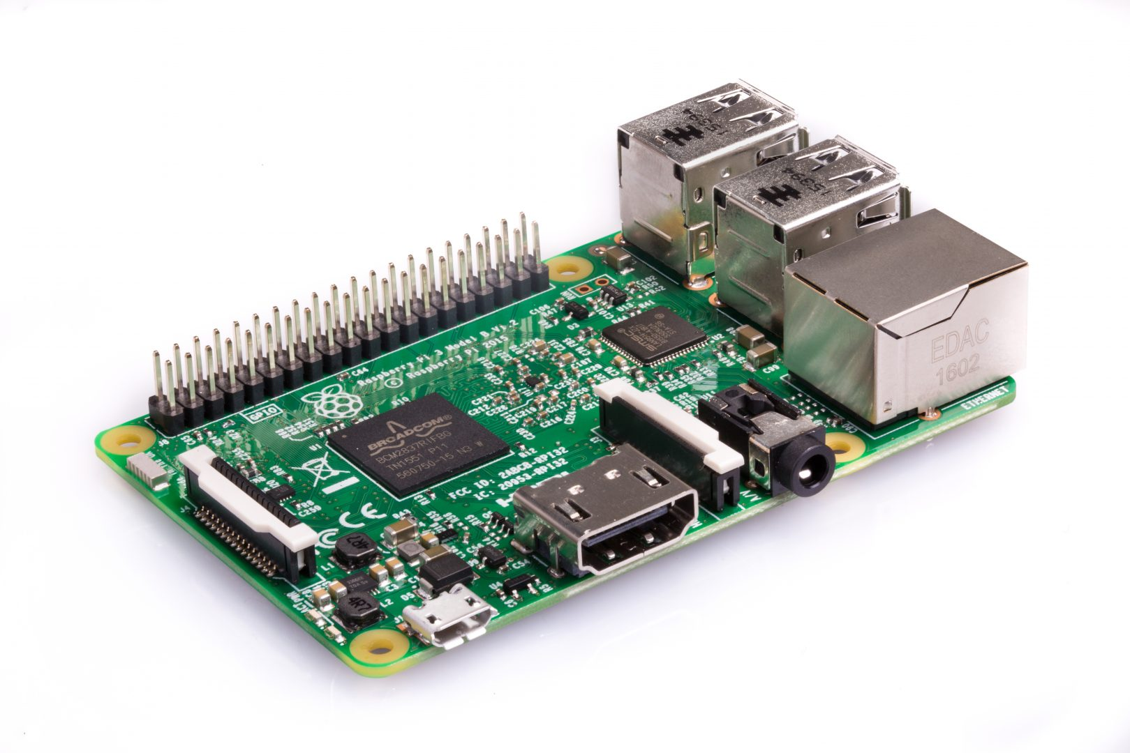
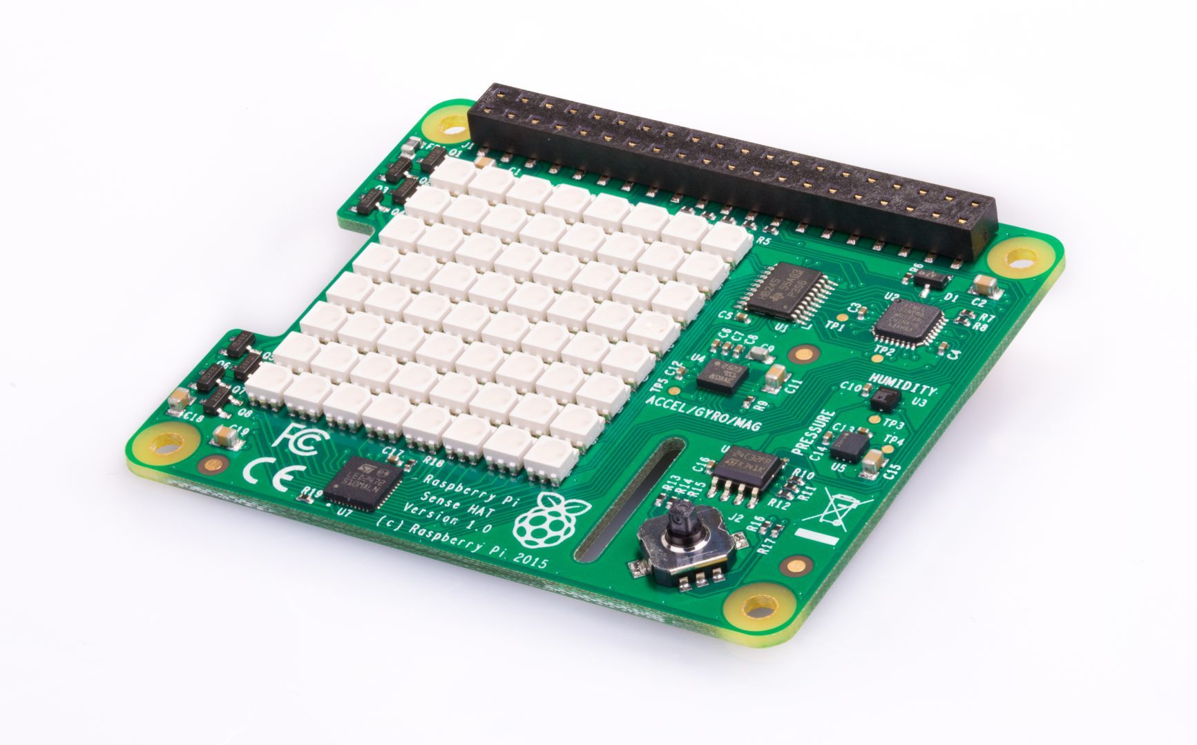
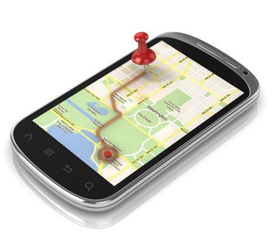
Hardware used
Raspberry Pi 3
Sense HAT
Smartphone GPS
Temperature Sensor
Accelerometer

Slide 4





software used
Python for Sense HAT
NodeJS for Blynk/GPS
Blynk to send GPS info
Data sent to Wia
eSpeak used for text to speech

Slide 5
How it works
The python script checks the temperature sensor and acceleration
Audio output depending on the temperature
Temperature and acceleration data sent to and displayed on Wia
NodeJS program connects to Blynk and Wia
NodeJS sends GPS co-ordinates to Wia
Location, temperature and acceleration are displayed on widgets on the Wia dashboard

Slide 6
Problems encountered & how they were solved
Python/NodeJS decision.
Node was chosen at first, difficulty developing, switched to Python.
Problems with Blynk in Python, decided to use both Python and Node.
Python was used for the bulk of the sensors, Node for phone & GPS.

Slide 7

Questions?

